Slide 1
Lab Traceroute, DNS steering, and TTL proof with Wireshark
Submission Template

Slide 2
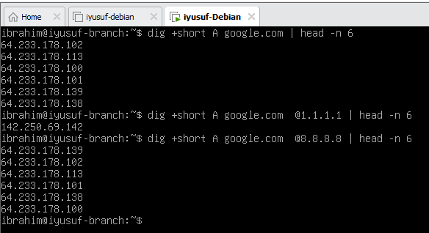
Screenshot 1 dig output
What changed when the resolver changed, and why does Google return multiple A records? Changing the DNS resolver returned different sets of IP addresses. Google provides multiple A records because it uses load balancing and geo-based routing, so users are directed to nearby or less busy servers

Slide 3
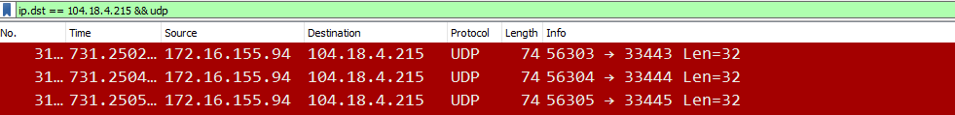
Screenshot 2 probe evidence
The probe type shown is a UDP probe. The packets are identified as UDP in the protocol column and the filter “ip.dst == 104.18.4.215 && udp” confirms the traceroute probes.
The protocol column also indicates a UDP packet.

Slide 4
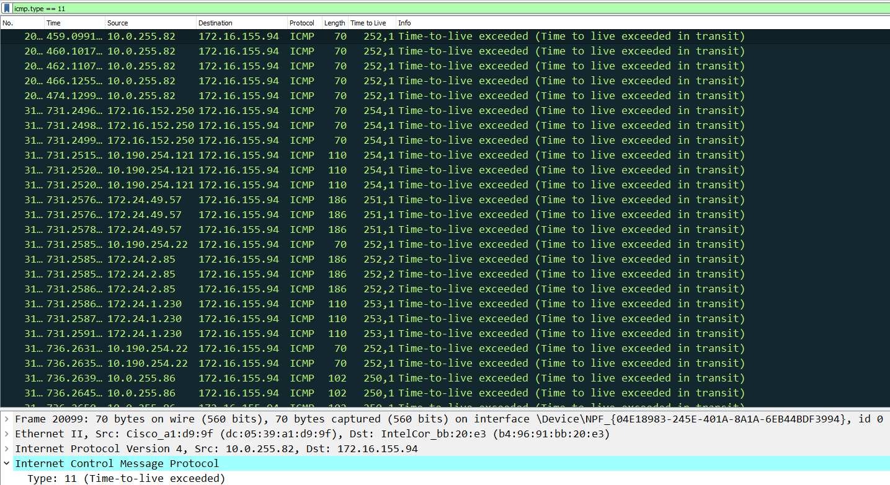
Screenshot 3 TTL proof
ICMP Time Exceeded indicates
that a packet’s TTL expired before
reaching the destination.
Traceroute sends packets of
Incrementing TTL values, which
Gradually reveals the full path.

Slide 5
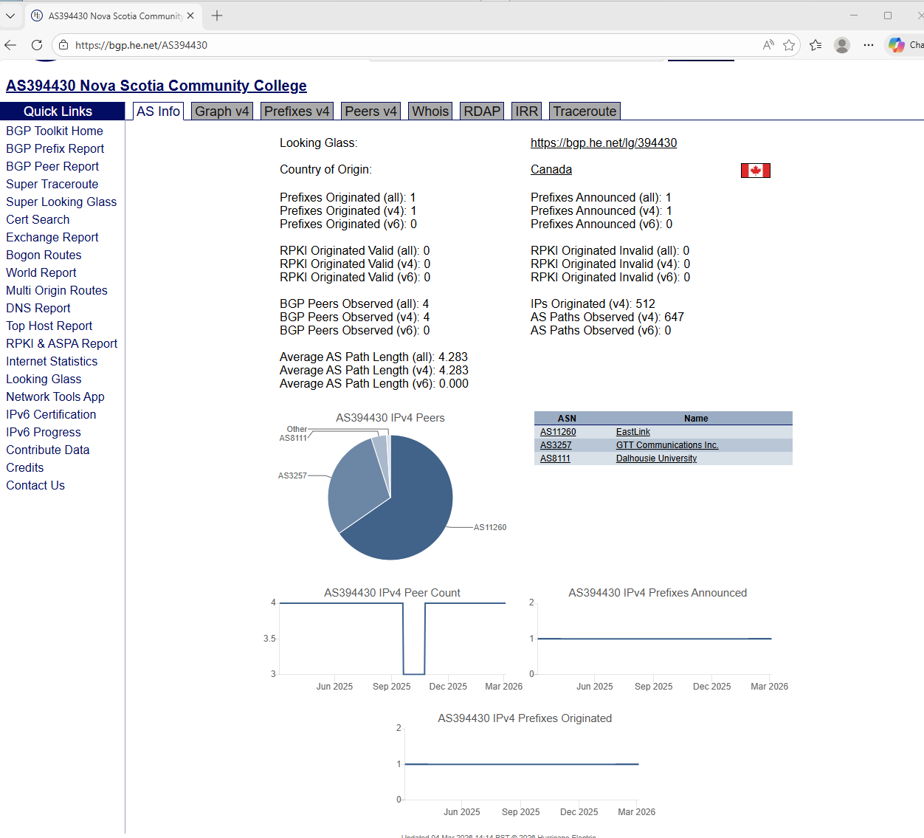
Screenshot 4 HE shows ASN context and neighbors

